Slide 1
VR and AR in Other Industries
Virtual and Augmented Realities

Slide 2
Contents
VR and AR in:
Medicine and Medical Care
The Automotive Industry
Architectural Visualization
Simulation
Case Studies
Further Reading

Slide 3
The Future of VR and AR
Technology is not only reshaping the way people do their existing jobs, it’s opening up a whole world of new ones
Interactive 3D is helping to simulate the real world in a meaningful way

Slide 4
Medicine
Doctors can practice surgery in virtual environments before ever touching a patient
it’s possible to not only simulate what a surgeon would see during the operation, but also how it should feel
VR played a vital role in the successful separation of conjoined twins at Masonic Children’s Hospital in Minneapolis
CT, ultrasound and MRI scans allowed doctors to venture inside their organs in VR to identify potential pitfalls

Slide 5

Medical Care
VR for pain an anxiety
Patients are using headsets to immerse themselves in a peaceful environment, taking focus off discomfort associated with medical problems and treatment
Burn patients who played “SnowWorld” reported 50% less pain
Stroke patients showed more improvement in arm and hand movement using VR Rehab compared to conventional rehab
SnowWorld is used to distract a burn patient from pain
Source: NBC News, 2020, 3 Ways Virtual Reality Is Transforming Medical Care

Slide 6
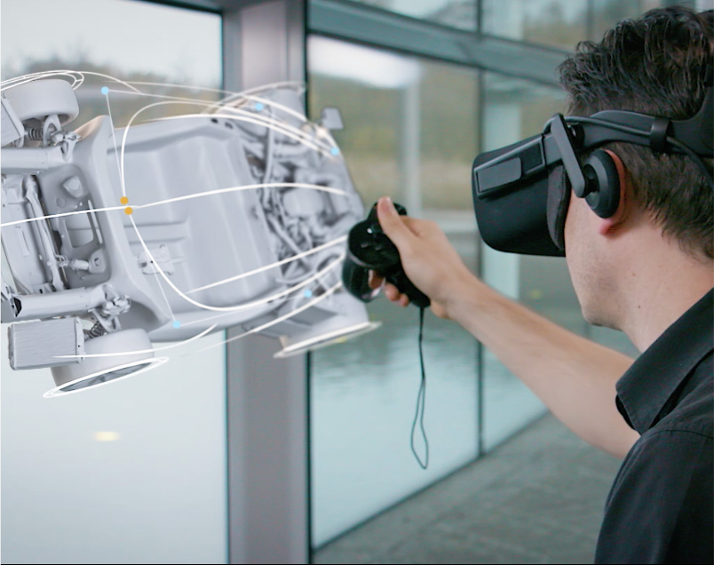
Automotive
Car designers no longer have to build full-sized clay models
They can try out and make changes to their designs in a virtual setting
Source: Burning Glass Technologies (2019) Visualizing the Future Demand for 3D Graphics and Real-time 3D Across the Economy

Slide 7
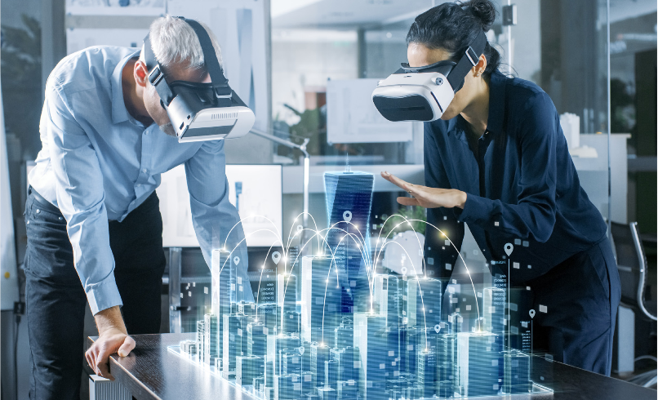
Architectural Visualization
Architecture, engineering, or construction
Engineers and artists interpret architectural designs and translate CAD data into 3D models
Source: Burning Glass Technologies (2019) Visualizing the Future Demand for 3D Graphics and Real-time 3D Across the Economy

Slide 8
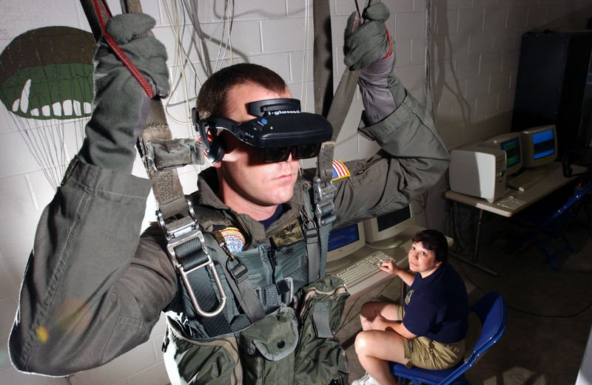
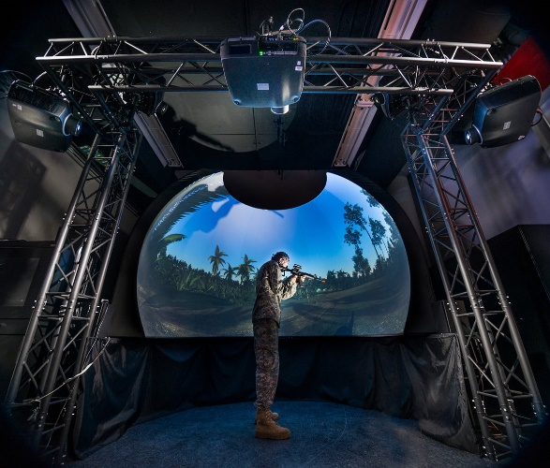
Simulation
Develop worlds for virtual testing
Enable developers to iterate faster and rely less on real-world testing
Applies to medical, automotive, and aerospace industries as well as military training simulations
3D visualizations, dynamic scenarios, and games for training replicating real-world situations

Slide 9
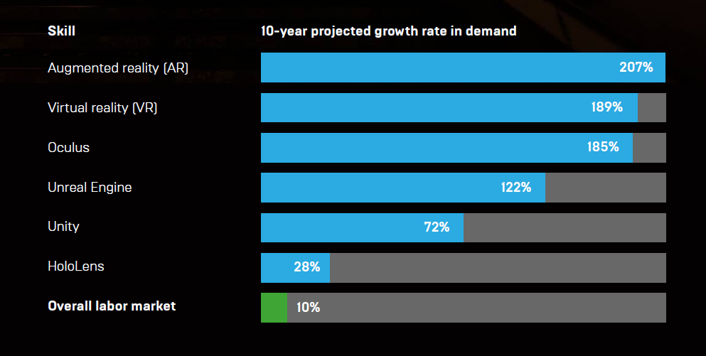
Projected Growth in Skills Demand

Slide 10
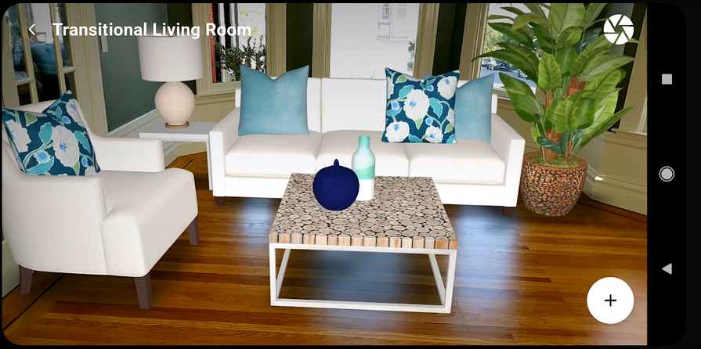
Case Study
Curate by Sotheby’s Realty - AR for Real Estate
Design your future home and shop for home furnishings through an immersive Augmented Reality experience
Built as a visualization tool for homebuyers, renters and real estate agents
Available on Google Play Store

Slide 11
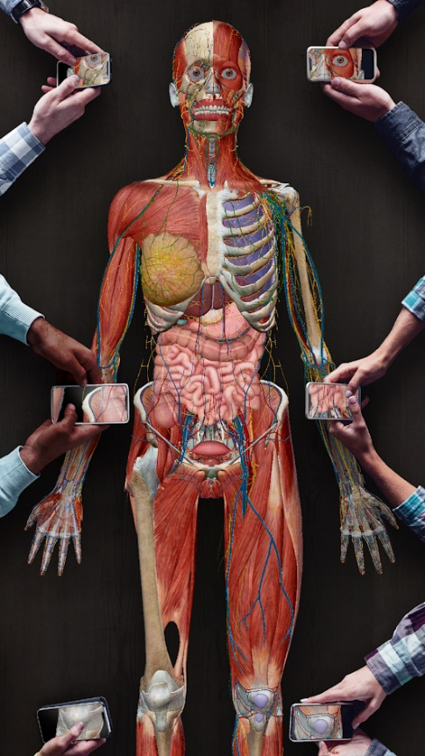
Case Study
Human Anatomy Atlas 2021: Complete 3D Human Body
Millions of medical professionals, students, and anatomy enthusiasts use Human Anatomy Atlas to see inside and better understand the human body with AR
Available on the Google Play Store

Slide 12
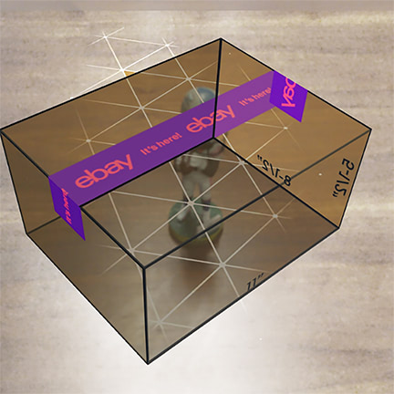
Case Study
eBay
Helps sellers figure out the best box to use for shipping their items to buyers
Available on the Google Play Store

Slide 13
Further Reading
Virtual Reality: A Distraction Intervention for Chemotherapy
https://www.ncbi.nlm.nih.gov/pmc/articles/PMC2121303/
Virtual Reality Versus Conventional Treatment of Reaching Ability in Chronic Stroke: Clinical Feasibility Study
https://www.ncbi.nlm.nih.gov/pmc/articles/PMC4389038/
The U.S. Army is building a giant VR battlefield to train soldiers virtually
https://www.digitaltrends.com/cool-tech/synthetic-training-environment-vr-training/#utm_source=r

Slide 14
References
Burning Glass Technologies (2019) Visualizing the Future Demand for 3D Graphics and Real-time 3D Across the Economy [ONLINE] Available at: https://www.burning-glass.com/research-project/visualizing_future_3d_skills_workforce/. [Accessed 31 March 2020].
NBC News. 2020. 3 Ways Virtual Reality Is Transforming Medical Care. [ONLINE] Available at: https://www.nbcnews.com/mach/science/3-ways-virtual-reality-transforming-medical-care-ncna794871. [Accessed 31 March 2020].

